Slide 1
Week 6 Class 1:
Building Landscapes
INST408C: Cognitive Security | Fall 2021 | SJ Terp

Slide 2
INST408C Week
Monday
Building landscapes
Wednesday
Building landscapes
Readings
Any country in the OII book
https://theconversation.com/misinformation-disinformation-and-hoaxes-whats-the-difference-158491
Assignments
Create a landscape assessment for a country, vertical, or organisation
Notes:
Links:

Slide 3
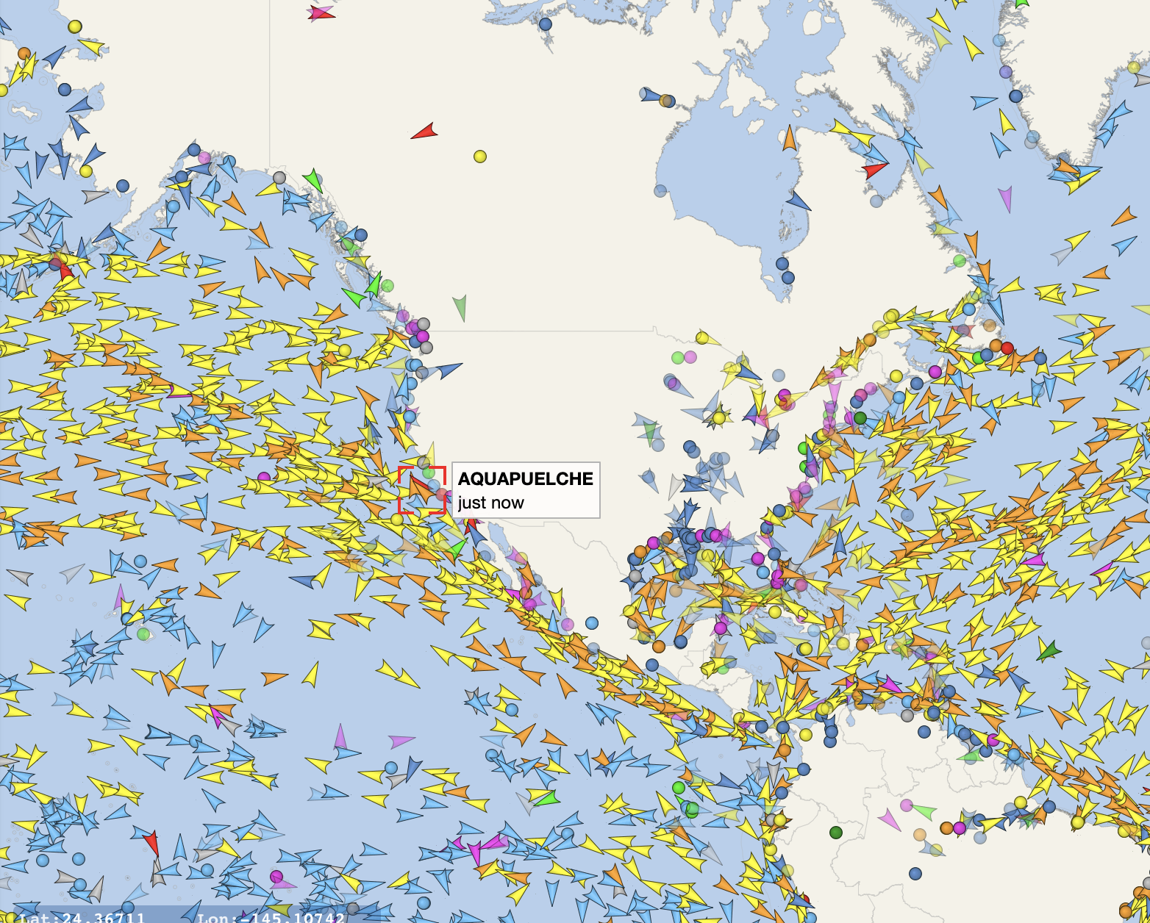
Landscape Contents
situation
Notes:
Links:
Vesselfinder snapshot, 3rd Oct 2021

Slide 4
Cognitive Security Ecosystems

Slide 5
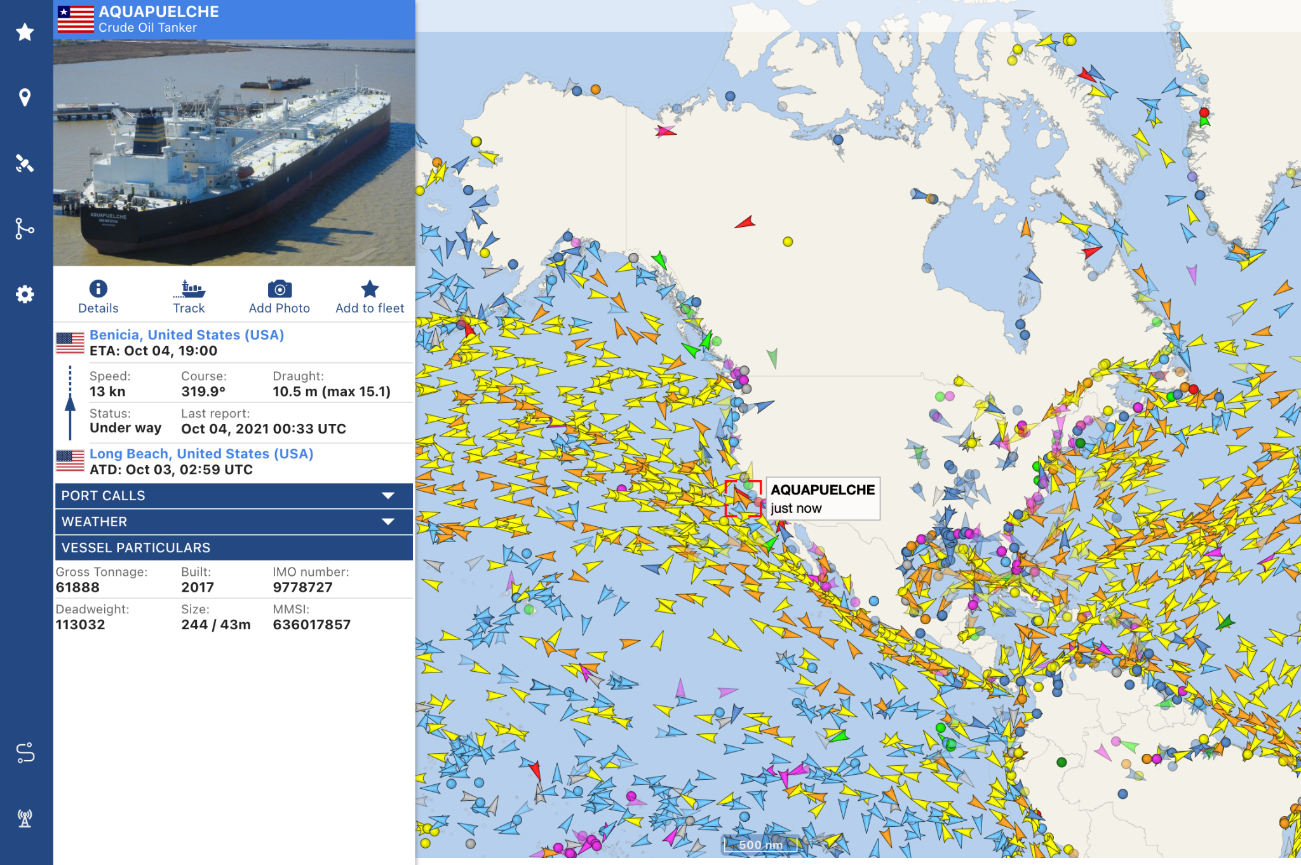
Map the territory
Notes:
Links
Vesselfinder.com snapshot, 3rd Oct 2021

Slide 6
Cognitive Security Ecosystem
Information Landscape
Information seeking
Information sharing
Information sources
Information voids
Threat
Landscape
Motivations
Sources/ Starting points
Effects
Misinformation Narratives
Hateful speech narratives
Crossovers
Tactics and Techniques
Artifacts
Response
Landscape
Monitoring organisations
Countering organisations
Coordination
Existing policies
Technologies
etc
Notes:
There are many actors in this space. We hear a lot about threat actors - these are at different scales, with different capabilities and motivations. They’re learning from each other, and they often interact - for instance, we see t-shirt sellers picking up geopolitical narratives.

Slide 7
Information landscapes

Slide 8
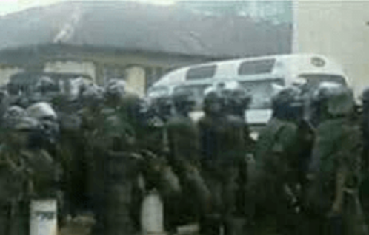
Example Information Landscape
Channels
Traditional Media
Newspapers
Radio - including community radio
TV
Social Media
Facebook
Whatsapp
Twitter
Youtube/ Telegram/ etc
Others
Word of mouth
Influencers
Groups
Messages
Notes:
Looking at information seeking, sharing, and posting behaviours.

Slide 9
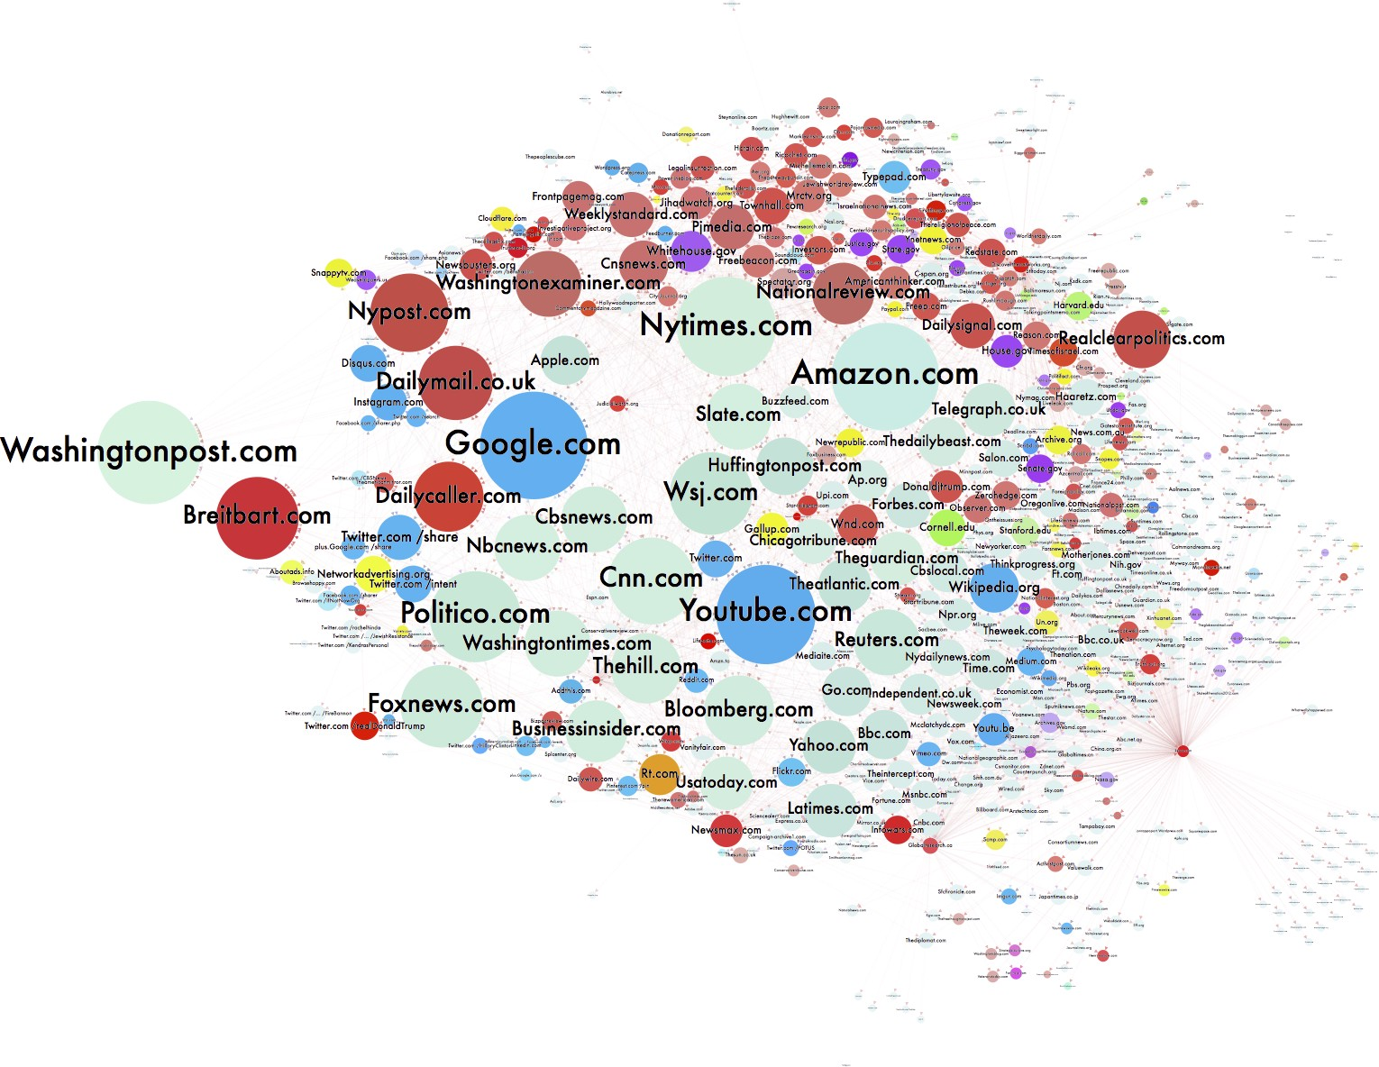
Channels
Lots of channels:
Where people seek, share, post information
Where people are encouraged to go
Image: https://d1gi.medium.com/the-election2016-micro-propaganda-machine-383449cc1fba
Notes:
IMage: https://d1gi.medium.com/the-election2016-micro-propaganda-machine-383449cc1fba

Slide 10
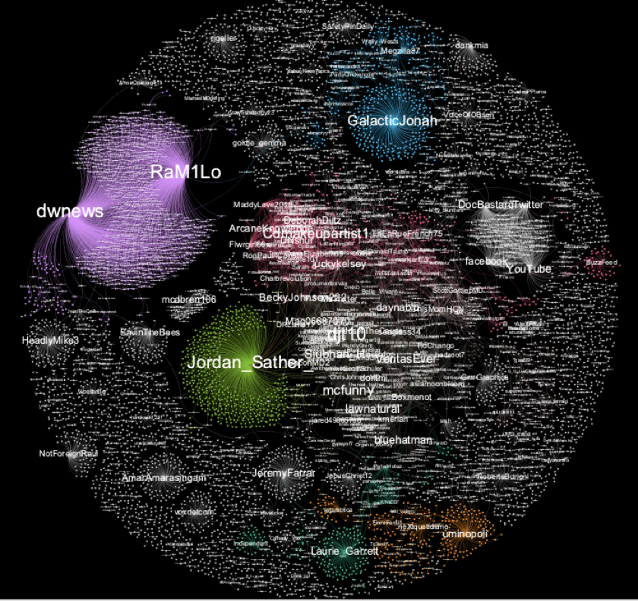
Influencers
Users or accounts with influence over a network
Not the most followers
The most influence
Might be large influence over smaller groups.

Slide 11
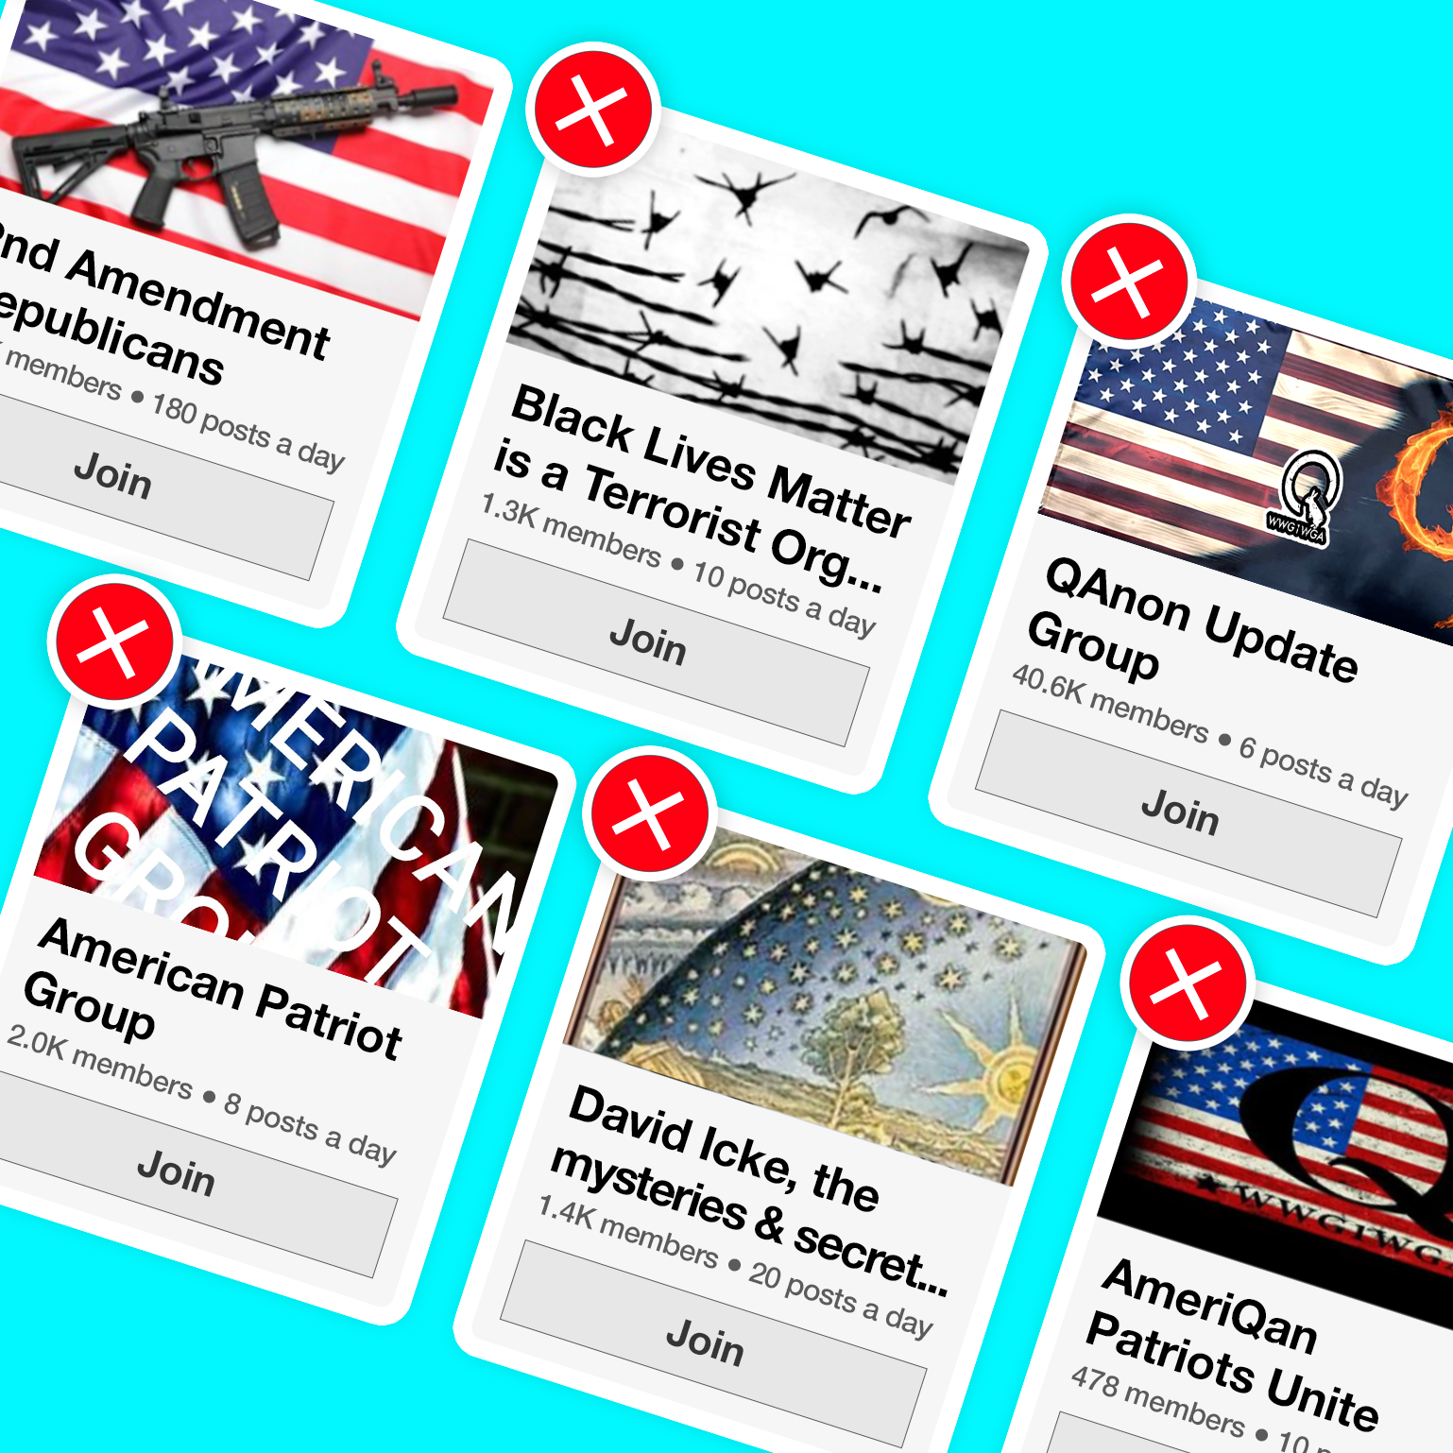
Groups
Social media groups created to create or spread disinformation
Often real members, fake creators
Lots of themes
Often closed groups
Notes:
Image: https://accountabletech.org/campaign/stop-group-recs/

Slide 12
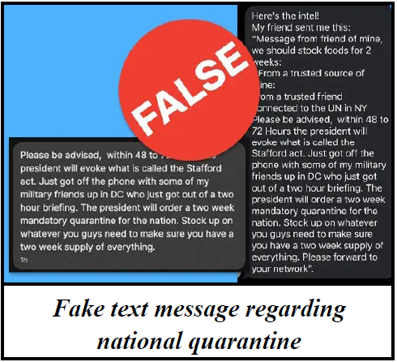
Messaging
Narratives designed to spread fast and be “sticky”
Often on a theme
Often repeated
Image: https://www.njhomelandsecurity.gov/analysis/false-text-messages-part-of-larger-covid-19-disinformation-campaign
Notes:
Image: https://www.njhomelandsecurity.gov/analysis/false-text-messages-part-of-larger-covid-19-disinformation-campaign

Slide 13
Threat landscapes

Slide 14
Example Threat Landscape
Motivations
Geopolitics mostly absent
Party politics (internal, inter-party)
Actors
Political parties
Nationstates
Entrepreneurs
Activities
Manipulate faith communities
discredit election process
Discredit/discourage journalists
Attention (more drama)
Potential harms / severities
Assassination
Voting reduction
Sources
WhatsApp
Blogs
Facebook pages
Online newspapers
Media
Routes
Hijacked narratives
Whatsapp to blogs, vice versa
Whatsapp forwarding
facebook to whatsapp
Social media to traditional media
Social media to word of mouth

Slide 15
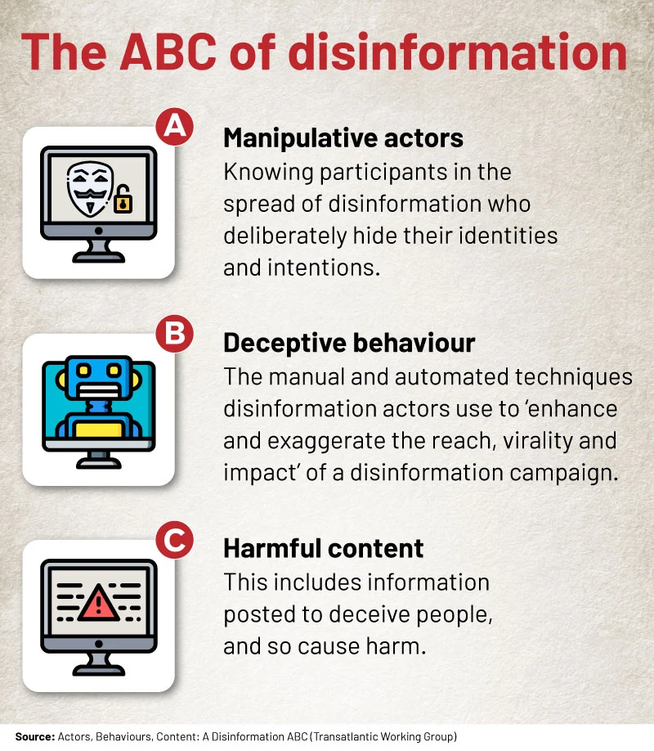
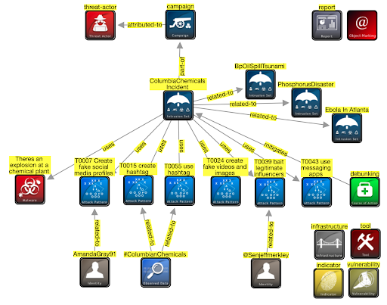
ABC model, STIX model
Notes:
ABC from https://africacheck.org/fact-checks/reports/anatomy-disinformation-campaign-who-what-and-why-deliberate-falsehoods-twitter

Slide 16
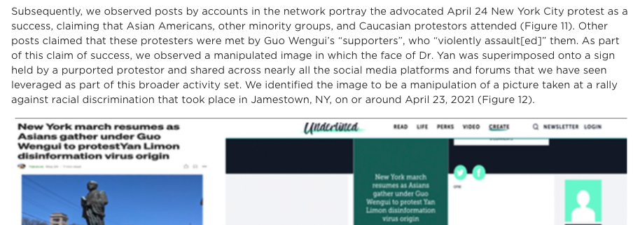
Incidents
Time-limited events (typically 2-3 days)
Areas include:
Elections
Disasters
Other events (e.g. Covid19)
Geopolitical support (e.g. Crimea)
Notes:
https://www.fireeye.com/blog/threat-research/2021/09/pro-prc-influence-campaign-social-media-websites-forums.html

Slide 17
Narratives
Covid isn’t serious
Covid doesn’t exist
Individual medical targets
Medical scams
MMS prevents
Alcohol prevents
etc
Origin myths
Escaped bioweapon
Country x created Covid
US soldiers took Covid to China
Resolution myths
Country y has a Covid cure
Crossover with conspiracies
Covid and 5G
Covid and antivax / anti-Gates
Helicopters spraying for covid
Depopulation conspiracy
Crossover with ‘freedom rights’
Anti- stayathome
2nd amendment
anti-immigration
Usual far-rightwing groups
Geopolitics
China, Iran: covert + overt
“Blue check” disinfo

Slide 18
Campaigns / Persistent Manipulators
Advanced Persistent Manipulators: “with resources, talent, and technology for advancing their influence over an enduring period” (Clint Watts)
Gen 1: disrupt the system: hacktivists
Hacking to shape public opinion
Gen 2: exploit the system: extremists (ISIS)
Social media influence
Gen 3: distort the system (Russia)
Social media influence fusion centre (personas, news sites, include in-person influence),
Gen 4: dominate the system (trolling as a service)
AI, social bots, false content, in-person, apps
Gen 5: Own the system (China, corporations)
Internet balkanisation to apps, create preferred reality
Notes:
https://www.fpri.org/article/2019/03/five-generations-of-online-manipulation-the-evolution-of-advanced-persistent-manipulators/

Slide 19
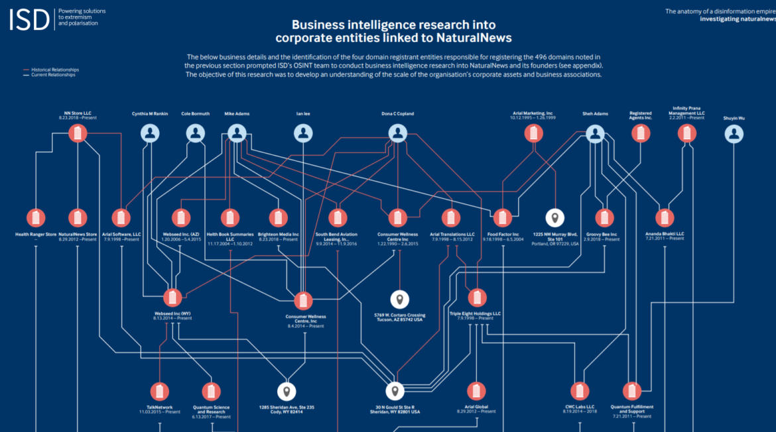
Actors
Entities behind disinformation
Nationstates
Individuals
Companies
Entities part of disinformation
DAAS companies
Image: https://gijn.org/2020/07/08/6-tools-and-6-techniques-reporters-can-use-to-unmask-the-actors-behind-covid-19-disinformation/

Slide 20
Disinformation Actors
Persistent Manipulators
Advanced teams
Internet Research Agency
China, Iran teams etc
For-profit website networks
Antivax websites
Pink slime sites
“Stolen” US election sites
Nationstate media
Sputnik
Russia Today
Service
Providers
Disinformation as a Service
Factories
Ex-marketing, spam etc
Ad-Hoc paid teams
EBLA Ghana
PeaceData USA
Opportunists
Wares Sellers
Clicks
T-shirts
Books etc.
Groups
Conspiracy groups
Extremists
Individuals
Attention-seekers
Jokers etc
Notes:
There are many actors in this space. We hear a lot about threat actors - these are at different scales, with different capabilities and motivations. They’re learning from each other, and they often interact - for instance, we see t-shirt sellers picking up geopolitical narratives.

Slide 21
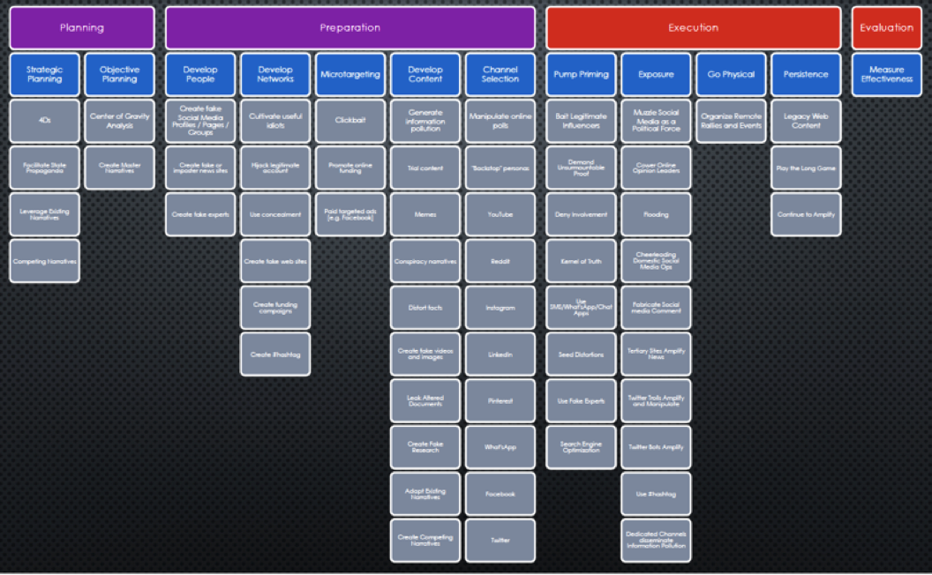
Behaviours
Techniques used in misinformation or disinformation campaigns
Useful to track because they’re often repeated, and we can design mitigations and countermeasures

Slide 22
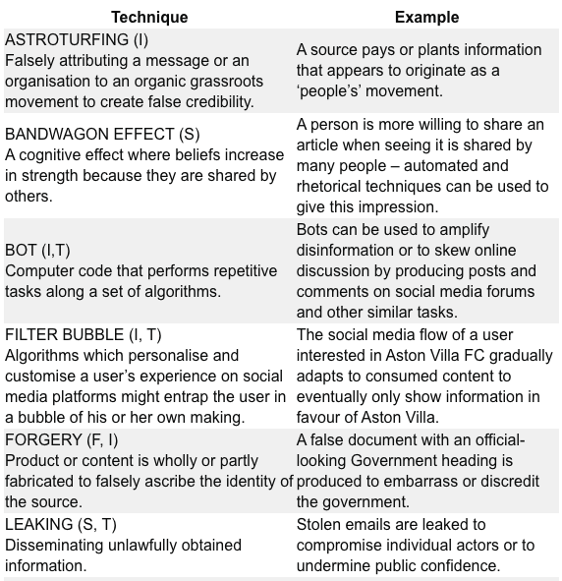
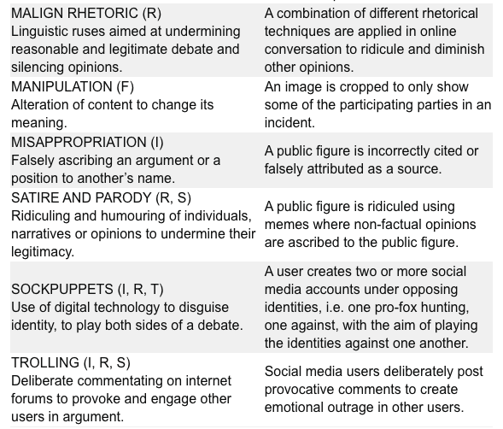
Behaviours (RESIST toolkit)
Notes:
https://gcs.civilservice.gov.uk/publications/resist-counter-disinformation-toolkit/

Slide 23
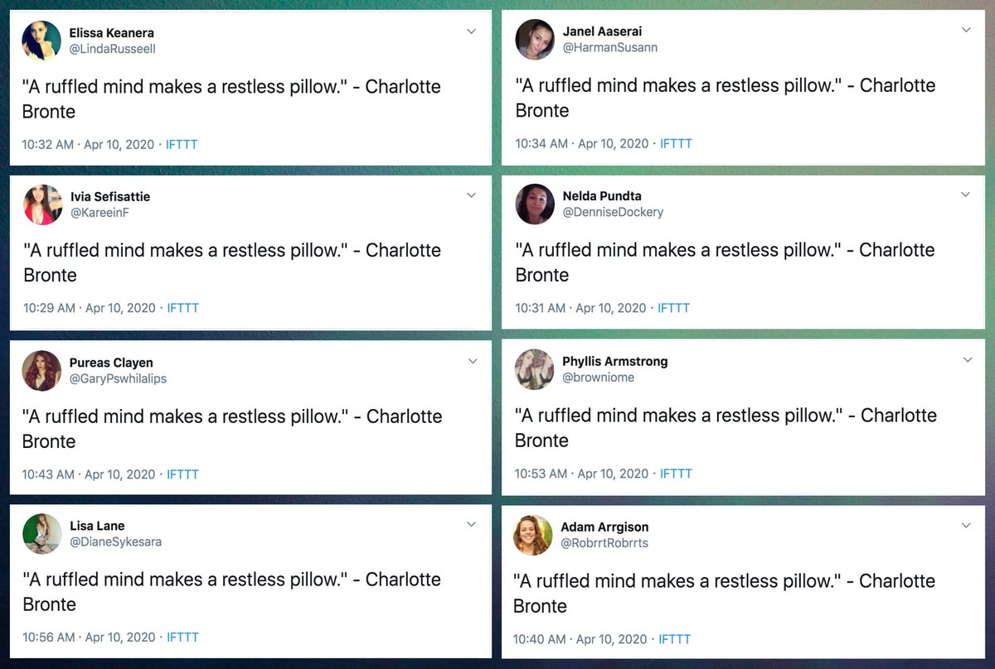
Tools
Bots
IFTTT variants
Personas
Network analysis
Marketing tools
Image: https://twitter.com/conspirator0/status/1249020176382779392

Slide 24
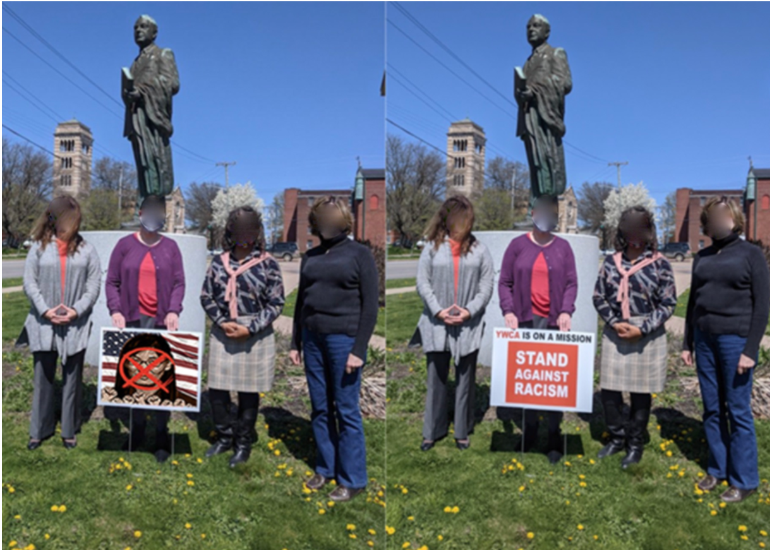
Artifacts
Text, images, videos, audio etc
Accounts, groups
Connections between them
Image: https://www.fireeye.com/blog/threat-research/2021/09/pro-prc-influence-campaign-social-media-websites-forums.html

Slide 25
Response landscapes

Slide 26
Response Actors
Disinformation SOCs
Large actors
ISAOs
Platforms
Other large actors
Event-specific
War rooms
Agencies
Disinformation Teams
Disinformation “desk"
In existing SOC
Standalone unit
Investigators
Journalists
Academics
Independent journalists
Other Responders
Policymakers
Law enforcement
Corporations
Influencers
Nonprofits
Educators
Individual researchers
Concerned citizens
Notes:
But there are also response actors in this space. These are also at different scales, with different motivations, capabilities, and connections. Our work is on how best to join these together into a coordinated rapid response.
And to do this, we’re borrowing the idea of a Security Operations Center or SOC - a coordinating unit, focussed on cognitive security, connected to other disinformation SOCs. These organizations are starting to exist. This won’t be the same for everyone, so we’re designing operations for different sizes of organization, from ISAO sized down to small teams embedded in an information security unit, to independent teams, with connections to a response network, maybe as information providers or responders.

Slide 27
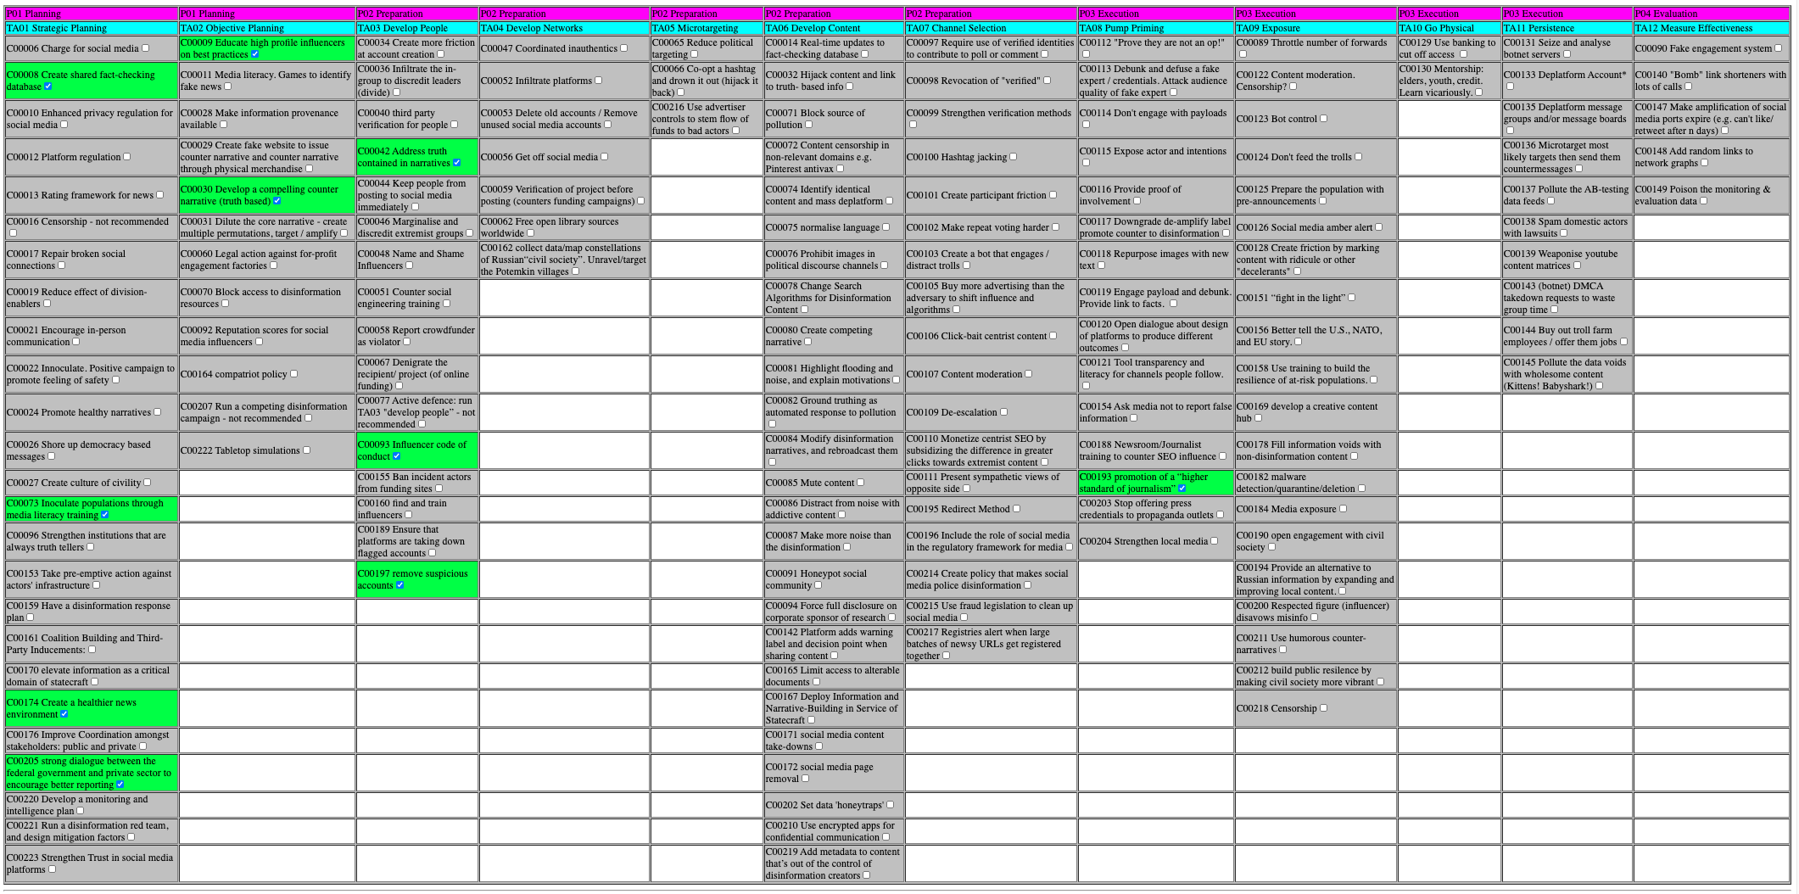
Behaviours
C00009: Educate high profile influencers on best practices
C00008: Create shared fact-checking database
C00042: Address truth contained in narratives
C00030: Develop a compelling counter narrative (truth based)
C00093: Influencer code of conduct
C00193: promotion of a “higher standard of journalism”
C00073: Inoculate populations through media literacy training
C00197: remove suspicious accounts
C00174: Create a healthier news environment
C00205: strong dialogue between the federal government and private sector to encourage better reporting

Slide 28
Example Response Landscape
(Needs / Work / Gaps)
Risk Reduction
Media and influence literacy
information landscaping
Other risk reduction
Monitoring
Radio, TV, newspapers
Social media platforms
Tips
Response
Messaging
prebunk
debunk
counternarratives
amplification
Actions
removal
other actions
Reach
Analysis
Tier 1 (creates tickets)
Tier 2 (creates mitigations)
Tier 3 (creates reports)
Tier 4 (coordination)

Slide 29
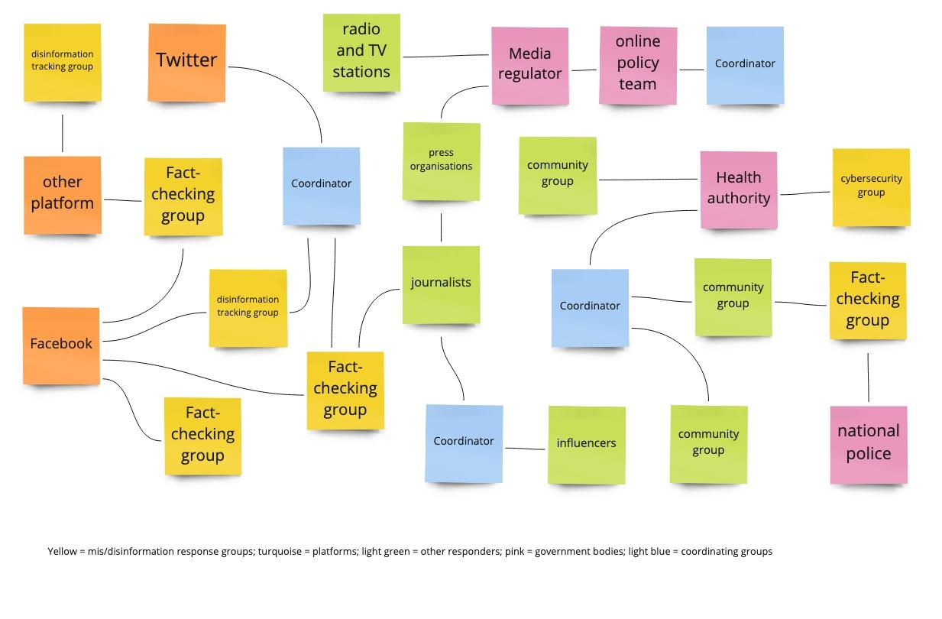
Ask about connections between groups

Slide 30
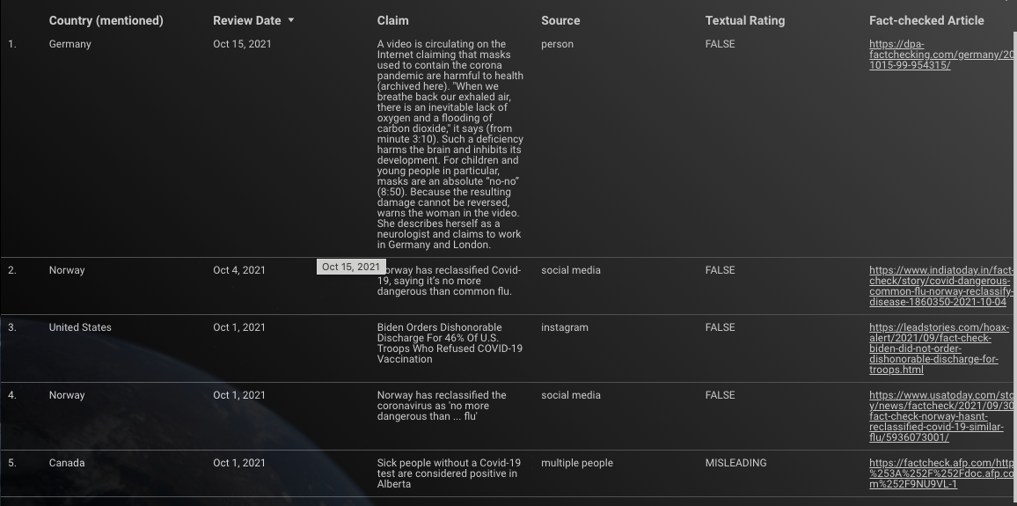
Content
Notes:
Image: https://datastudio.google.com/reporting/5283a98c-af82-451b-8cb1-cd86f5915568/page/MM

Slide 31
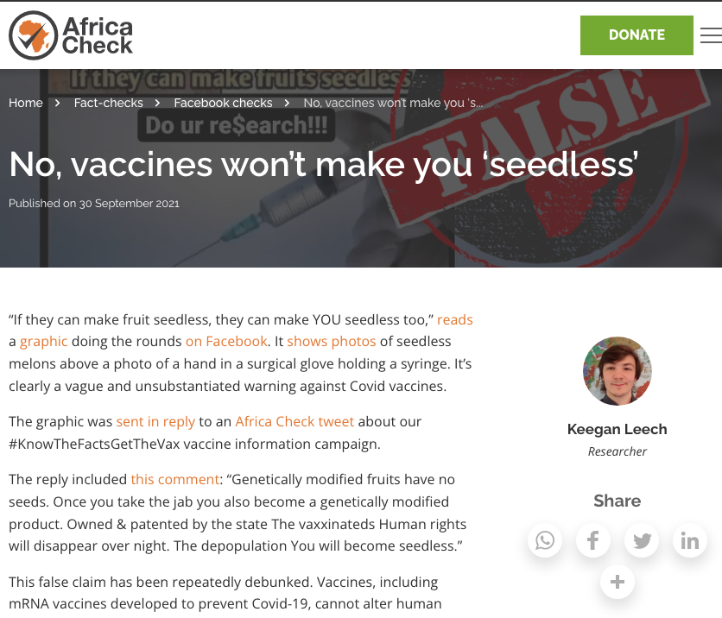
Content
Notes:
Image: https://africacheck.org/fact-checks/fbchecks/no-vaccines-wont-make-you-seedless

Slide 32
Recommendations

